Slide 1
Option F Augmentation
Roy Falik and Michael Kloc

Slide 2
Overall Problem
There is no easy way to run a SIM database in a manner that could be used in an enterprise setting.

Slide 3
Goal
Using Apex JSON and REST packages, as well as Carnot, develop a way to run a SIM database that doesn't require substantial investment of capital or time

Slide 4
Foundation
The other team working on Option F implemented a method to allow for List of Values in Apex to be queried from a SIM database.

Slide 5
Expansion
The next logical step is to create a method that can create tables. This obviously requires changing how parameters are handled, as List of Values are a display and return value, whereas tables can have any number of columns.
This introduces a problem of how do we allow any number of columns to be requested? We need a dynamically changing set of parameters.

Slide 6
Brainstorming Solutions
Create a more generalized version of the LoV, that functions on more than simply a display and return column

Slide 7
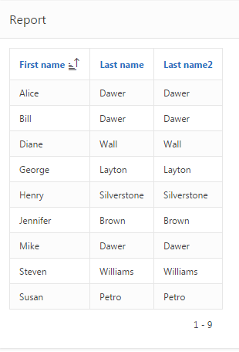
Generalized LoV
CREATE OR REPLACE TYPE returnObjectType
AS OBJECT
(
R_ID INT,
col1 VARCHAR(255),
col2 VARCHAR(255),
col3 VARCHAR(255),
col4 VARCHAR(255),
col5 VARCHAR(255),
col6 VARCHAR(255),
col7 VARCHAR(255),
col8 VARCHAR(255),
col9 VARCHAR(255),
col10 VARCHAR(255)
)
Return object has many columns- not all of which need to be used
Number of columns user is trying to select is recorded. Those columns are populated with values
Rest are simply declared null
Demonstration select:
SELECT col1 AS "First Name", col2 as "Last Name", col3 as "Last Name2"
FROM TABLE(rwp.doTable('person', '[first_name], [last_name], [last_name]','[person_id]'))

Slide 8
Generalized LoV - How?
General idea: the query is fired to return the entire table. Use the returned JSON to build and pipe each row
Idea: Initialize the return object and for each row in the returned JSON, set the attributes of the object based on the return JSON
Failed. There are only two ways to modify the attributes of an object: setter functions and using “dot-access”
Setter functions method: requires a setter method for each column in the table
Dot-access: makes it difficult to dynamically update elements (eg how do I assign object.col1 through object.col5 one time, but only object.col1 another time?)
Idea: Populate a collection to represent the row values and then create the return object from the collection
Failed. Could not access fields of the collection within the return object constructor

Slide 9
Generalized LoV - How?
General idea: the query is fired to return the entire table. Use the returned JSON to build and pipe each row
Idea: Similar to before, use a collection to dynamically hold the values then create the return object based on the collection
Success. We stored each of the values of the JSON “row” into a collection of varchars and then used this to populate the piped row:
PIPE ROW (returnObjectType(i,data(1), data(2), data(3), ….., data(9), data(10)));

Slide 10
Generalized LoV - Disadvantages
Defined number of columns. If you ever need more than 10 you need to update the code.
Currently, everything is a varchar. Could not figure out a way to get type information from the JSON.
Future work: Specify in the selection clause the type of the return column. However, this would require the return object to be dynamically built.

Slide 11
Brainstorming Solutions
Create a more generalized version of the LoV, that functions on more than simply a display and return column
Create a return object that can adapt. We will dynamically design the return object based on how many columns we need.

Slide 12
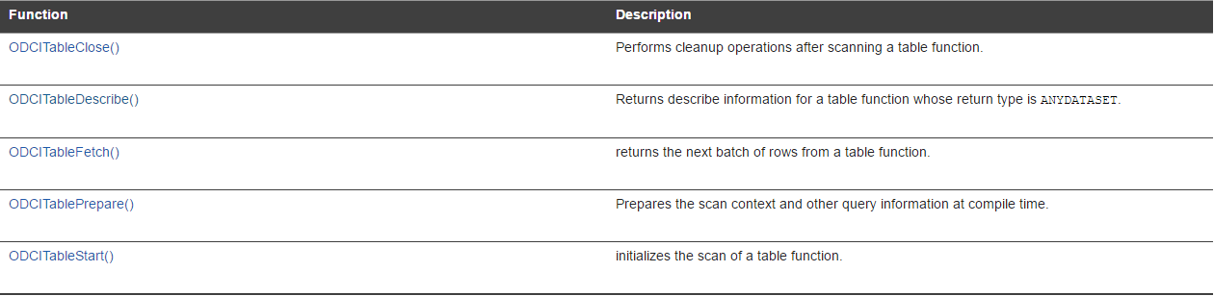
Dynamic Return Type
Believe it or not- this is actually possible.
Oracle Data Cartridge Interface
AnyDataSet
Allows return of a variable type from a pipelined function and implements the ODCI

Slide 13
Future Work
Implement the ODCI and AnyDataSet combination in order to create a truly dynamic report based on a REST query
Resources have been included in our github repo- an example ODCI/ADS implementation has been constructed in ‘ODCI_anydataset_example.sql’

Slide 14
Summary/Logistics
Final working demo SQL file = ‘Form_with_unused_columns/RWP_undefined_form.sql’
APEX export of working demo is in main folder
README.md contains link to this presentation and to working APEX application
Note that Carnot must be up and running for APEX app to function

